Slide 1
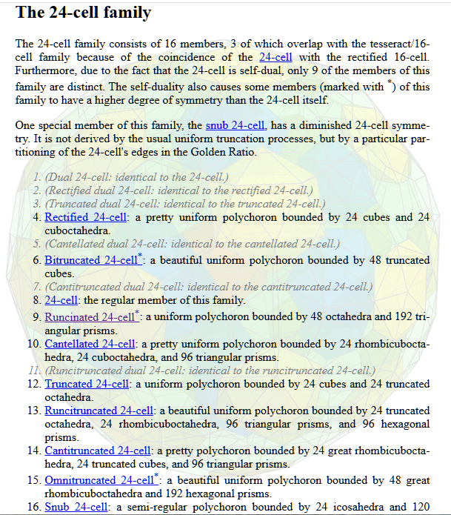
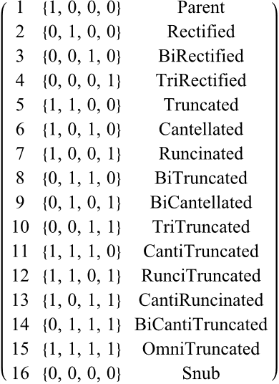
1= 4
2= 3
3= 2
4= 1
5= 10
6= 9
7*
8*
9= 6
10= 5
11=14
12=13
13=12
14=11
15*
16*
1= 4
2= 3
5=10
3= 2
6= 9
8*
11=14
4= 1
7*
9= 6
12=13
10= 5
13=12
14=11
15*
16*
0/1
x+y=15

Slide 2
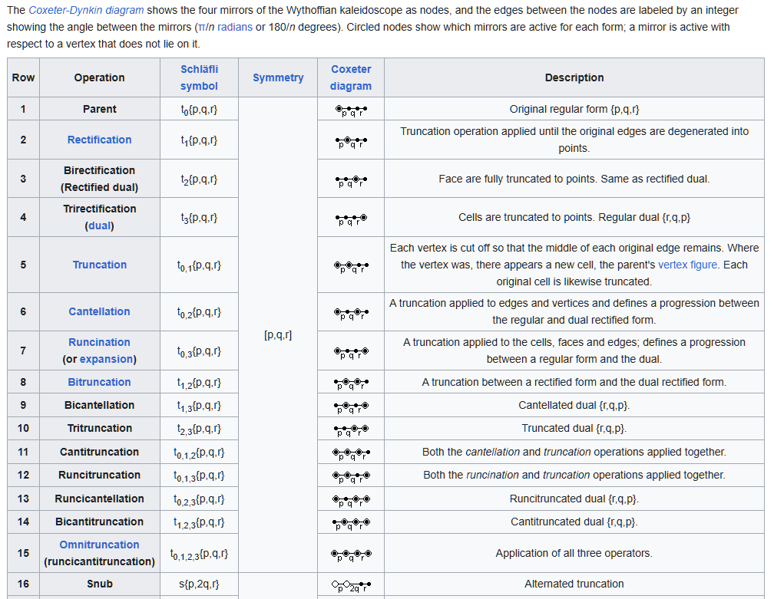

Slide 3
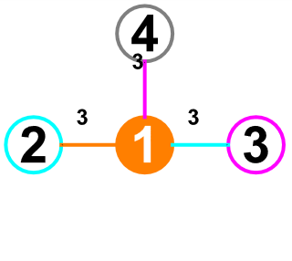
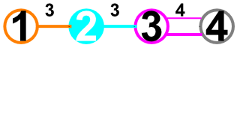
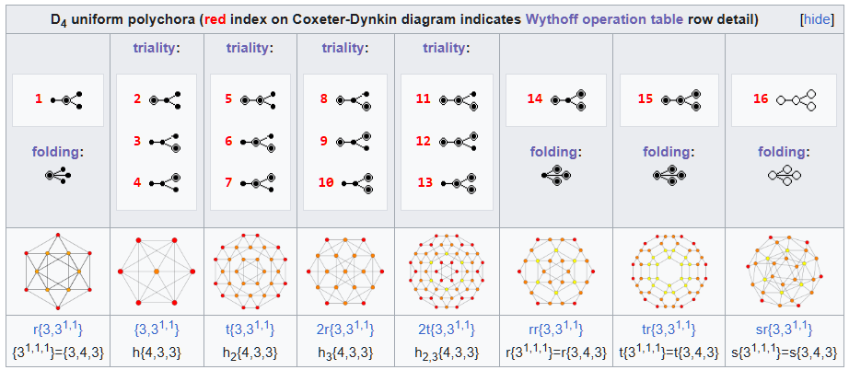
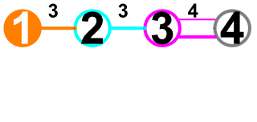
D₄ Uniform Polychora
D4 24-cell parent =
B4 16-cell rectified
vertices: 24 24/96 288/192 288/192 576 576 1152 96
Palindromic Operations
x+y=15
96 288 92 576
96 288 288 576
24 192 144 576
=0
0/1
0/1
B4 16-cell / 8-cell
rects
D4
truncs
w/ p
D4
truncs
w/o p
D4
canti-
truncs
D4
D4
D4
D4
D4
F4
F4
F4
F4
parent
omni rect
omni trunc
snub

Slide 4
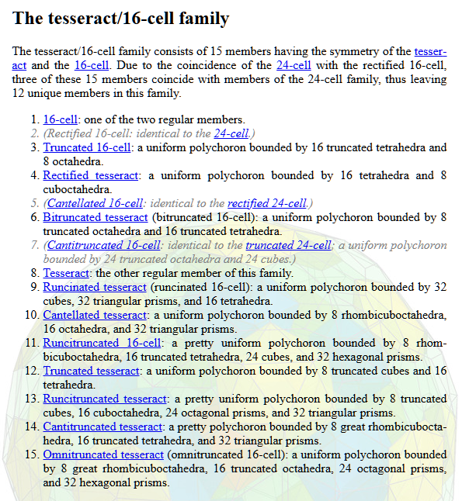
1
2
5
3
6
8
11
4
7
9
12
10
13
14
15

Slide 5
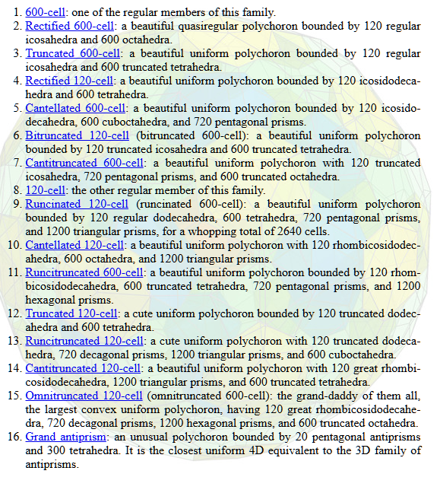
1
2
5
3
6
8
11
4
7
9
12
10
13
14
15
16

